Slide 1


Airline Delay Analysis
This project uses Power BI to extract meaningful insights from airline datasets. Through careful data cleaning, data enrichment and visual story telling, the project delivers high impact insights relevant to improve airline business operation.
Done by : Uthman Olusola Yusuf
Done by : Uthman Olusola Yusuf
Title : Data / Power Bi Analyst
Title : Data / Power Bi Analyst
Email : uthman.yusuf04@outlook.com
Email : uthman.yusuf04@outlook.com

Slide 2
Overview
This exploratory data analysis leverages Power BI to extract meaningful insights from comprehensive airline operational data spanning two years, multiple carriers, and airports. The dataset includes key metrics such as flight volumes, delay categories, cancellations, and diversions across diverse time periods and geographic locations.
Key Analysis Areas:
Delay patterns across five primary categories: carrier issues, weather, national aviation system, security breaches, and late aircraft
Seasonal variations and temporal trends
Carrier performance comparisons
Geographic patterns and airport-specific insights
Flight volume versus delay correlations
Through interactive Power BI visualizations, this analysis provides actionable insights to understand delay root causes, identify performance gaps, and support data-driven decision making for improved airline operations and passenger satisfaction.

Slide 3

Dataset Overview
Data Source & Scope
Source: FP20 Analytics
Time Period: 2-year coverage
Scope: Multiple carriers, airports, and operational metrics
Key Performance Metrics
Delay Rate: Percentage of flights experiencing delays >15 minutes
On-Time Performance Rate: Percentage of flights arriving within 15 minutes of scheduled time
Data Dimensions
Temporal: Year, Month
Carrier: Carrier ID, Carrier Name
Geographic: Airport codes, names, latitude/longitude
Operational: Flight volumes, delay categories, cancellations, diversions
Data Preparation
Data cleaning and validation completed
Data enrichment performed to enhance analysis capabilities
Dataset prepared for visual storytelling and interactive analysis
Analysis Limitations
Analysis scope limited to 2-year period
Results reflect historical performance within this timeframe

Slide 4
Business Questions:
What are the busiest months and airports for flights?
Which months experience the highest delay rates?
How do delay patterns vary across different airlines?
What are the primary causes of delays (e.g., carrier reasons, weather, late aircraft)?
Which airports are most affected by weather-related delays?
How do delays differ between peak and off-peak seasons?
Are there geographical patterns in delay occurrences (e.g., coastal vs. inland airports)?
Do certain regions experience higher delays due to weather conditions?
What percentage of total flights experience delays of over 15 minutes?
Are there airports or airlines with significantly better on-time performance?

Slide 5

Methodology
Power BI Analysis Approach
Interactive Dashboards: Dynamic visualizations enabling multi-dimensional data exploration
Data Modeling: Established relationships between carriers, airports, time, and delay categories
Visual Storytelling: Comprehensive charts including scatter plots, bar charts, and donut charts
Filtering Capabilities: Year-over-year comparisons with interactive slicers
Key Performance Indicators (KPIs)
Delay Rate: 17.10% - Percentage of flights delayed >15 minutes
On-Time Performance Rate: 82.90% - Percentage of flights arriving within schedule
Delay Minutes by Category: Total delay time breakdown by cause
Travel Season Analysis: Peak vs off-peak performance comparison
Geographic Performance: Regional delay pattern identification

Slide 6
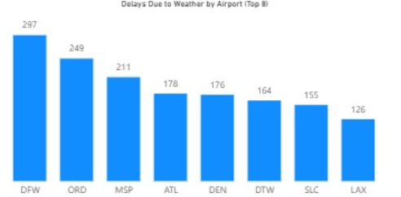
Analysis Framework
Temporal Analysis: Monthly delay trends and seasonal patterns
Categorical Analysis: Five delay causes (carrier, weather, systems, security, late aircraft)
Geographic Analysis: Airport region performance (inland vs coastal)
Carrier Benchmarking: Top 7 airline performance comparison
Operational Efficiency: Flight volume correlation with delay patterns

Slide 7

Key Findings Summary
High-Level Insights and Trends
Overall Industry Performance
17.10% delay rate with 82.90% on-time performance indicates strong operational efficiency
Industry maintains reliability despite operational challenges
Performance consistency across 2-year analysis period
Seasonal Performance Patterns
Winter months (Jan-Feb) show highest delay rates at ~19%
Fall season (Nov) demonstrates optimal performance at ~15%
4-percentage point seasonal variation reveals predictable patterns
Geographic Performance Variations
Coastal airports experience higher weather-related delays
Inland airports show different operational challenges
Regional factors significantly impact delay patterns

Slide 8

Key Findings Summary
Most Significant Delay Patterns Discovered
Weather Dominance
Weather emerges as the primary delay driver across all airports
Uncontrollable external factor represents largest operational challenge
Geographic correlation between weather delays and airport location
Carrier Performance Gaps
Top-performing carriers maintain consistent on-time rates
Performance variation exists across different airline operational models
Carrier-specific delays represent controllable improvement opportunities
Travel Season Impact
Peak travel periods correlate with increased delay rates
Off-peak seasons show improved operational efficiency
Capacity management influences delay patterns during high-demand periods

Slide 9
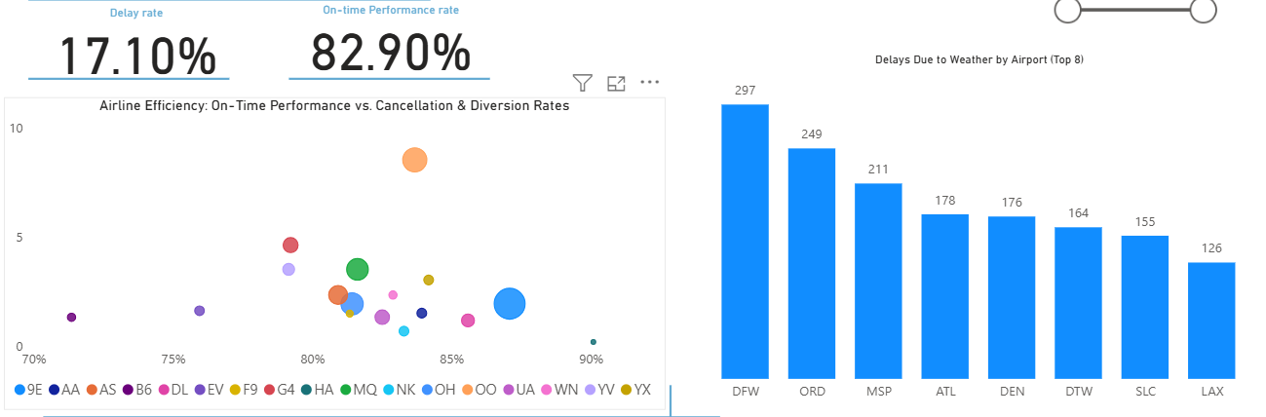
Airline Delay Analysis
Airline Efficiency Overview
SkyWest Airlines Inc.
On-time performance: 83.68% (highest)
Cancellation rate: 8.51%
Diversion rate: 49.38%
Allegiant Air
On-time performance: 79.22%
Cancellation rate: 4.61%
Diversion rate: 16.98%
SkyWest leads in punctuality but shows a high diversion rate, suggesting possible rerouting issues.
Allegiant balances moderate punctuality with lower cancellation and diversion rates.
🌧️ Delays Due to Weather by Airport
Dallas Fort Worth (DFW): 297 delays — most affected by weather
Chicago O’Hare (ORD): 249 delays
Marcos Paz Airfield: 211 delays
🔹 These airports experience the highest frequency of weather-related delays 🔹 Suggests potential regional climate challenges or weather management inefficiencies

Slide 10
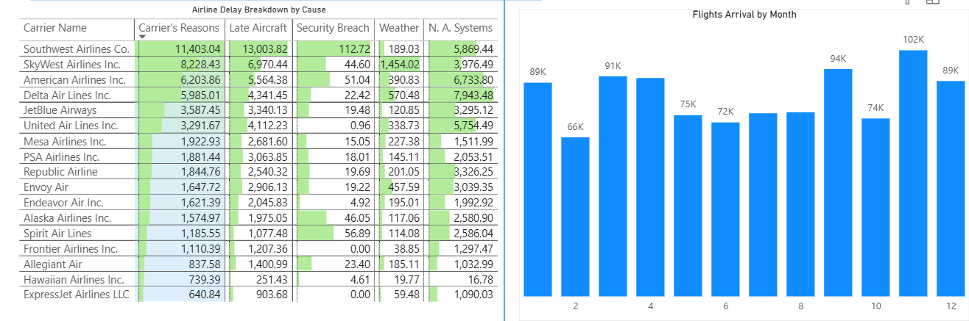
Airline Delay Analysis
Delay Causes by Airline – Key Highlights
Southwest Airlines Co. reports the highest delay counts among all carriers.
Late aircraft arrival: 13,003 delays
Carrier-related issues: 11,403 delays
NAS delays: 5,869 delays
Weather-related: 189 delays
Security delays: 113 occurrences
SkyWest Airlines Inc. and American Airlines Inc. follow in delay frequency.
Majority of delays are operational (carrier & late aircraft), not external (weather/security).
Indicates potential internal inefficiencies in scheduling, fleet, or turnaround management.
Flight Arrivals by Month
November: Highest arrivals — 102,000 flights
September: 94,000 flights
March: 91,000 flights
November leads in flight volume, possibly due to peak travel periods or seasonal demand.

Slide 11
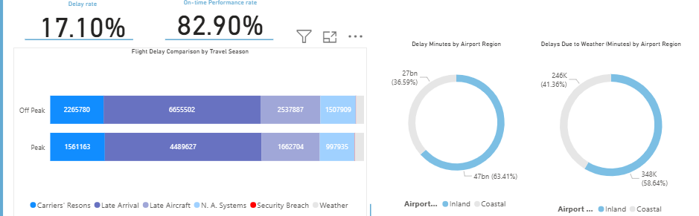
Airline Delay Analysis
Flight Delays by Season
Delays vary slightly across seasons, with no extreme spikes.
Off-peak seasons (e.g., late winter, early fall) show higher overall delay counts across all major causes.
Indicates resource optimization or demand imbalance during quieter travel periods.
Understanding seasonal patterns can guide better staffing and scheduling strategies.
Delay Distribution by Airport Region
Total Delay by Minutes
🏞️ Inland airports: 63.41%
🌊 Coastal airports: 36.59%
Delays Due to Weather
🏞️ Inland: 58.64%
🌊 Coastal: 41.36%
Inland airports experience significantly higher delays, both in total minutes and weather-related causes — possibly due to geographic or infrastructural factors.

Slide 12
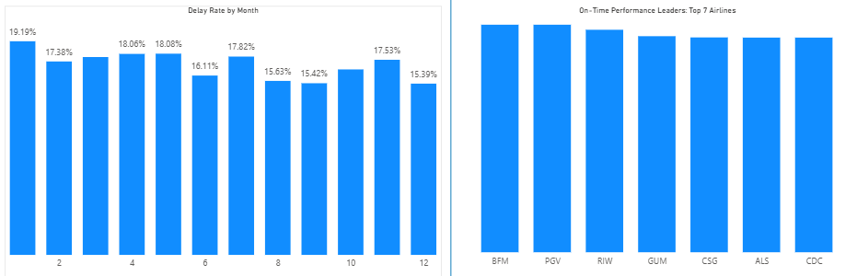
Airline Delay Analysis
Top Performers by Rating (Low Volume, High Performance)
Frontier Airlines Inc.
Pitt-Greenville Airport
Central Wyoming Regional Airport
🔹 These entities achieved the highest performance ratings 🔹 However, they recorded low flight arrival counts
➡️ High efficiency may be influenced by lower traffic volume, enabling better control over operations and fewer delays.
Flight Delays by Month (Top 3)
January: 19.19%
May: 18.08%
April: 18.06%
🟡 These months reflect the highest delay rates, potentially linked to:
❄️ January – Winter weather disruptions
🌸 April–May – Spring travel peaks and transitional weather patterns

Slide 13

Recommendations
Actionable Insights for Stakeholders
For Airlines
Benchmark against top performers achieving 80%+ on-time performance
Implement seasonal staffing strategies for peak delay months (Jan-Feb)
Focus on controllable delays: carrier-related and late aircraft issues
Develop proactive weather contingency plans for weather-prone routes
For Airports
Enhance capacity management during peak travel periods
Implement regional coordination for weather delay mitigation
Invest in infrastructure to address capacity constraints
Optimize ground operations to reduce turnaround times
For Regulatory Bodies
Establish performance standards based on 17.10% delay rate baseline
Implement enhanced oversight during peak delay periods
Invest in National Aviation System infrastructure improvements
Facilitate best practice sharing among high-performing carriers

Slide 14
Airline Delay Analysis
Areas for Operational Improvement
Immediate Actions (0-6 months)
Target underperforming airlines with focused improvement plans
Implement enhanced weather monitoring and response systems
Develop comprehensive winter operations strategies
Establish real-time delay tracking and response mechanisms
Medium-term Initiatives (6-18 months)
Balance flight volumes with operational capacity during peak periods
Establish collaborative delay management across airport regions
Implement predictive analytics for proactive delay management
Enhance operational efficiency through targeted staff training
Performance Targets
Short-term: Reduce delay rate from 17.10% to 15% within 12 months
Long-term: Establish 12% delay rate as industry standard

Slide 15

Airline Delay Analysis

Slide 16
Airline Delay Analysis
Summary of Key Takeaways:
Industry performance baseline - establishing the 17.10% delay rate and 82.90% on-time performance as benchmarks
Critical delay drivers - weather dominance and carrier-related improvement opportunities
Performance insights - gaps between carriers and geographic impacts
Actionable opportunities - immediate steps for improvement
Future Analysis Opportunities:
Enhanced data integration - expanding data sources for deeper insights
Advanced analytics - implementing predictive modeling and machine learning
Expanded scope - broadening analysis to international operations and new technologies
Strategic planning - developing industry-wide improvement frameworks
Stakeholder engagement - creating collaborative improvement systems

